Slide 1
Digital viticulture technology for the Canberra Wine District
AgTech Event Presentation

Slide 2
Introduction
VSCD 'Digital Viticulture' Progression Project facilitated by Hans Loder (Vitifelix)
Builds on PTUP project (2022-2023) drone trials & GIS mapping with side on imaging (Bitwise & Greenseeker)
Series of workshops conducted aligned with key vineyard stages
Focus: drone mapping, AgTech tools, and evaluating costs/benefits

Slide 3
Digital viticulture technology for the Canberra Wine District
Before you get started
Final Report Case Studies:
Drone Mapping vineyard block boundaries and optimal flight times for vegetative mapping during the season
Processing map imaging through open-source software and creating block features and areas of interest
Bringing it all together, storing and managing data
AgTech options for vineyard monitoring and management
Conclusion: What next?
Side on imaging using RGB / NDVI sensors for bud, bunch, canopy, plant counts and health

Slide 4
Workshops Overview
31 Aug. 2023
Workshop 1 (Online, Aug 31, 2023): Image/data capture overview, drone mapping software (Airborne Logic, Mammoth Geospatial)
29 Sep. 2023
Workshop 2 (Budburst, Sept 29, 2023): Drone mapping, BitWise bud/bunch count, NDVI data collection (Pankhurst Winery)
1 Dec. 2023
Workshop 3 (Flowering, Dec 1, 2023): Drone maps, GPS data with RTK Rover, NDVI capture with Greenseeker (Norton Road Wines)
1 Mar. 2024
Workshop 4 (Veraison, Mar 1, 2024): Mobile NDVI, real-time GPS data transfer, QGIS mapping (Quarry Hill Vineyard)

Slide 5
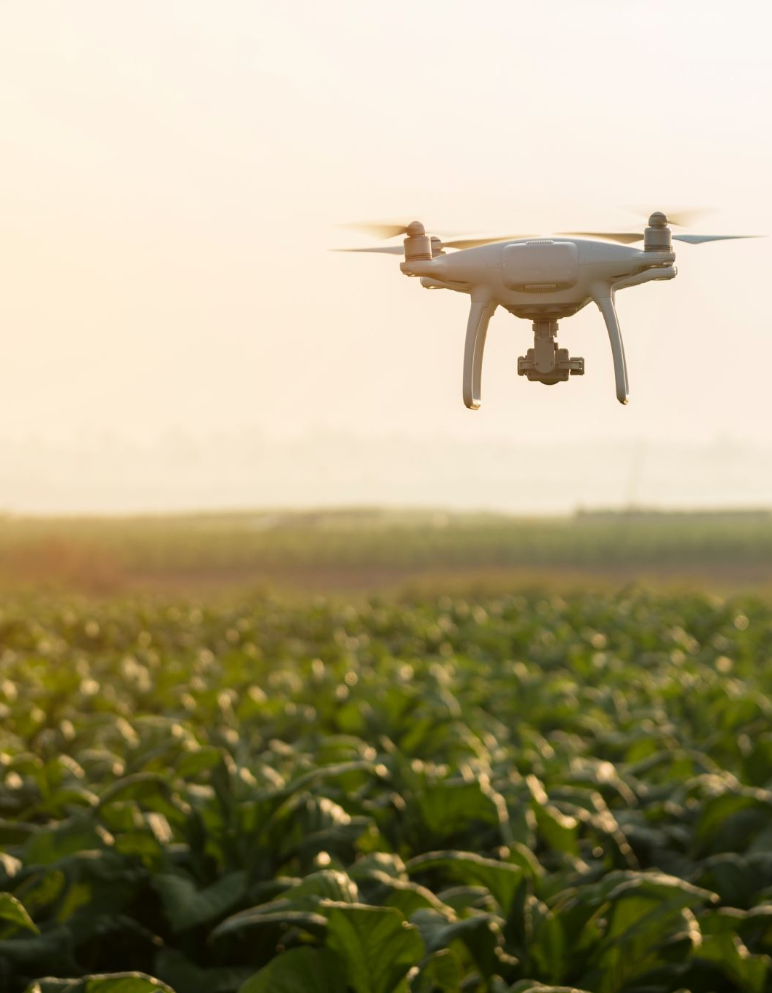
Before you get started
The use of drone and side on imaging enables growers to monitor and assess vineyard performance through creating a ‘digital asset’
The project trialled a range of technologies, including drones, mapping software, RGB / NDVI top and side on imaging, and RTK precision point mapping.
The software platform we used QGIS is open source and allows for layering of maps and analysis of vine blocks, rows and plants.
The cost for an individual grower of this equipment and expertise could be prohibitive – now a shared resources for VSCD members
Project materials will be made available on www.canberragrapes.net.au

Slide 6
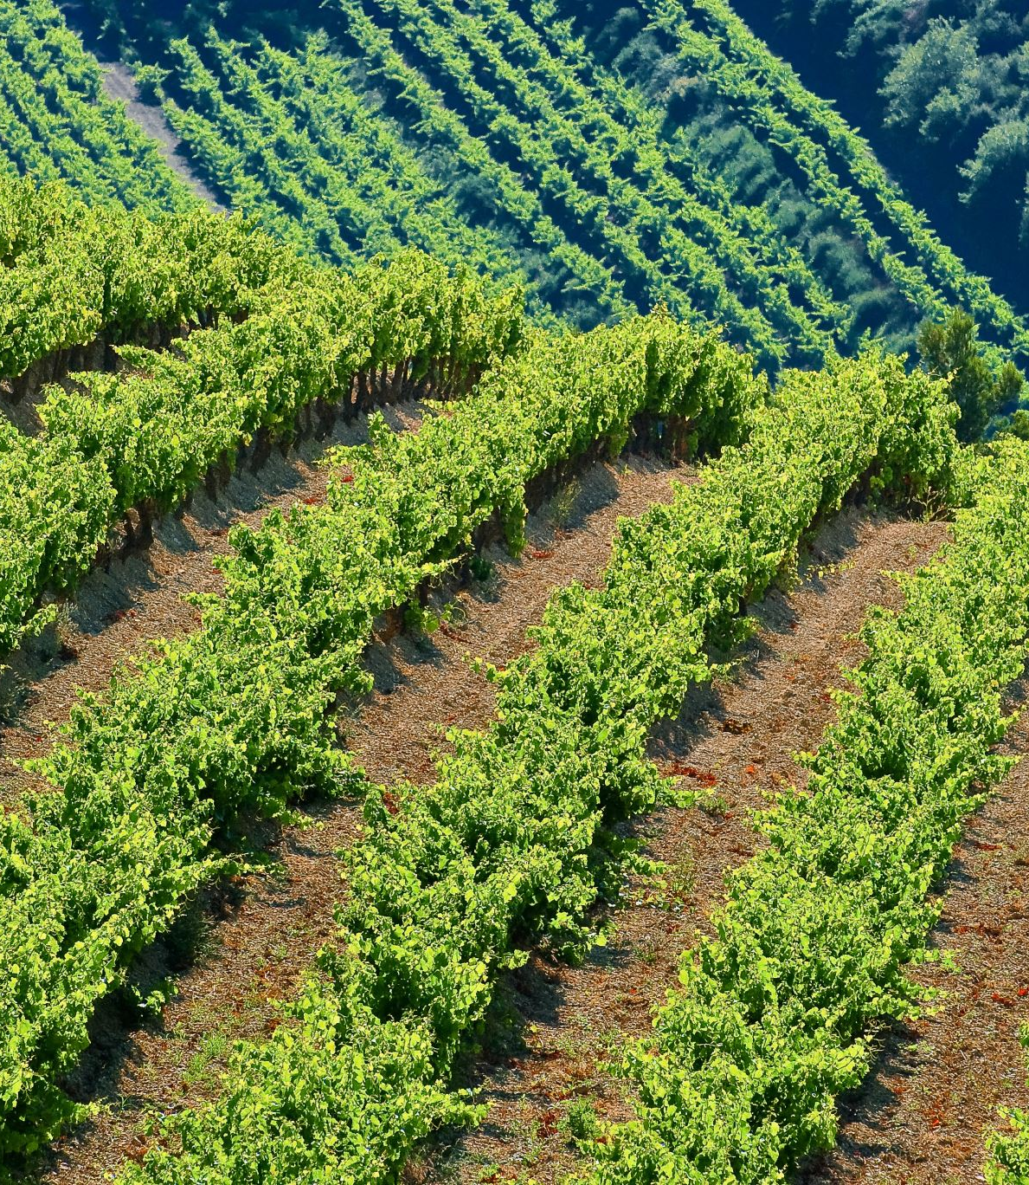
Key Finding: Vendor vs DIY Approach Cost vs. Benefit: using vendors vs shared DIY resources. Considerations: Time, capital, and knowledge investment required to manage digital viticulture assets. Scale of vineyard operations and specific needs determine the most cost-effective approach.

Slide 7
Vendor vs Collaborative Approach
Finding 1: Some technology can be accessed easily and affordably through a DIY approach.
Finding 2: Outsourcing certain tasks to vendors can save time and offer more specialised results.
Case Studies: Alternative options to vendor solutions were explored, providing valuable cost comparisons.

Slide 8
Risks & Continuity in AgTech
Technology Risks: Reliance on evolving platforms and vendors carries risks (competition, acquisitions, support continuity).
Mitigation: Use of compatible software formats and standards can ensure map continuity and future access.
Collabriculture Project: Provided foundational data organisation standards for the viticulture sector.

Slide 9
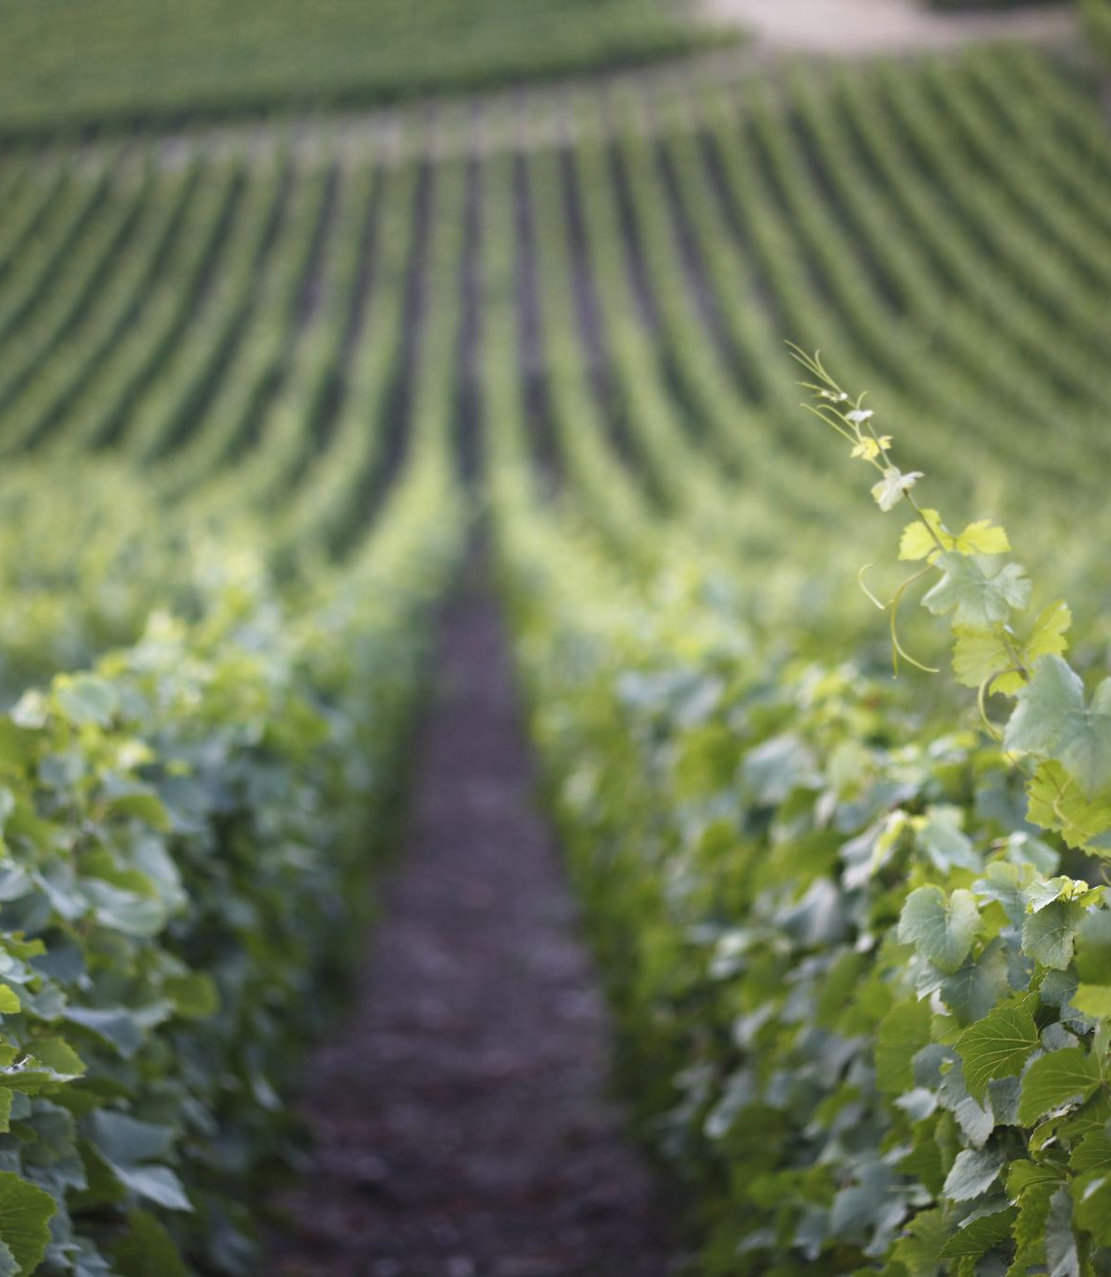
Viticulture Vignettes: Use Cases
Key Use Cases Showcased:
Establishing digital twins for vineyards.
Mapping frost events and optimising frost fan positions.
Estimating bunch yield and canopy health.
Monitoring vineyard dieback and grafting success.

Slide 10
Conclusion
Digital mapping provides foundation for future AgTech – a ‘Digital Asset’
Representational, accurate and accessible data – ‘send off an alert’
Future autonomous vehicles – spray drones / driverless tractors?
‘Tri-angulate and ground truth’
Training AI – algorithms and machine learning - to identify disease and pests for vines – preventative and treatment applications?

